Slide 1
The Pharmaceutical /Sales Representatives of Today:
The Good , The Bad, and The Ugly.
Presented by
Ken Onuegbu FPSN & Ifeanyi Emenne

Slide 2

WHY REPS

Slide 3
Sales Reps and Pharm Reps -Why do we need them?
The primary reason why companies recruit PSR and SR is to drive their sales and marketing plans
Ensure that these goals are achieved ultimately
In Doing This
Negotiate and close deals and handle complaints or objections
Collaborate with team members to achieve better results
Gather feedback from customers or prospects and share with internal teams
Set up meetings with potential and existing clients and listen to their wishes and concerns
Actively seek out new sales opportunities through cold calling, networking and social media

Slide 4
In doing this…they…
Negotiate and close deals and handle complaints or objections
Collaborate with team members to achieve better results
Gather feedback from customers or prospects and share with internal teams
Set up meetings with potential and existing clients and listen to their wishes and concerns
Actively seek out new sales opportunities through cold calling, networking and social media

Slide 5

The Story Of The Good, The Bad, The Ugly

Slide 6
The Good
Take a look at all the Pharmaceutical companies in Nigeria still standing tall today.
Most of these companies have moved from zero to billions, from nothing to great. From one SKU to more than 100 SKUs.
You cannot tell the story of any great company today without sharing the stories of GOOD Pharmaceutical and Sales Representatives.

Slide 7
The Good
That Emzor Pharmaceuticals is among the top Pharmaceutical companies in Nigeria today with a turnover above N20 Billion, is a credit you must partly give to the good among us.
When you hear about Ciprotab, Astymin or Astyfer, think about the good reps who have done exceptionally well.
Tell me that successful brand in the market today, and l will show you the good people around the brand-
  Lonart
  Rocephin
  Augmentin

Slide 8
Liitle wonder….
We have seen good reps moved to top management positions like Executive Directors, Deputy Managing Directors, CEOs and even owning their own successful companies

Slide 9

The Good

Slide 10
The Good Qualities
Takes Ownership
Believes that performance is the only job security you can have
Team players
Sound product and territory knowledge
Excellent in relationship building.
Self motivated
They think big and do not settle for mediocrity

Slide 11

The Bad

Slide 12
Qualities of a Bad Rep
Cannot achieve a single month sales target in a period of one year
Finds it difficult to file necessary activity report.
Struggles to cover his or her territory
Tells a lot of stories and relies a lot on excuses
Blames everybody but himself for failures
Lacks product knowledge and shows lack of interest to learn

Slide 13
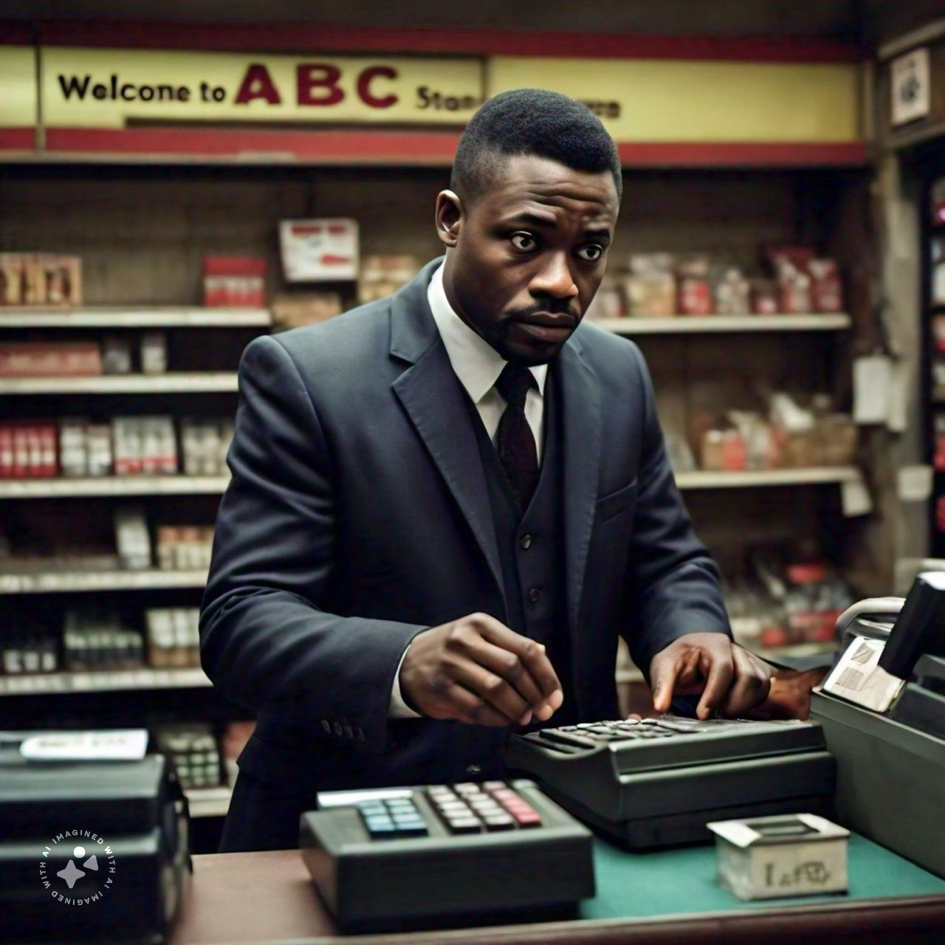
The Ugly

Slide 14
Ugly Qualities
Rep working in more than one
Terrible reps
Not ready to create any single value for the company
Are criminlas that dupe both ther company and customers
They don’t care about the survival of the company

Slide 15

EXAMPLES AND LESSONS

Slide 16
Lessons
Avoid recruitment in a hurry. Carry out your proper background search.
Take a good and cursory look at the CV of your candidates and demand for an explanation on all job gaps on the CV. Make a concerted effort to reach out to the former employers.
Our sales managers should wake up and do their jobs
Top management should stop employing candidates with carry over baggages.

Slide 17
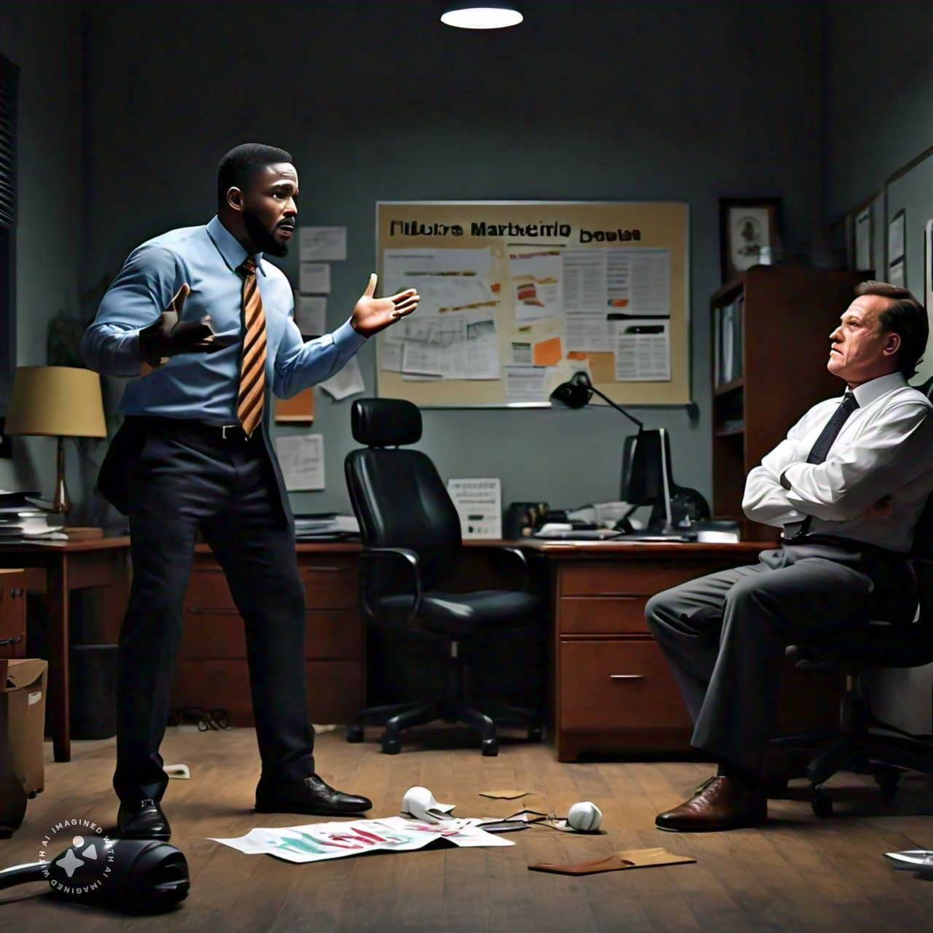
Another Ugly story

Slide 18
LESSONS CONTINUE
Do proper documentation, verification and background check for each of your reps - Reps disappear without trace
2. Have someone work with a new rep at least for two weeks before deploying them - Some reps are lazy and two weeks work together will expose such reps
3. Have your fidelity insurance, accident insurance and other insurance packages in place - reps can disappear with goods and vehicle and defraud customers
Good salary Good incentive helps a lot
4. Managers must work with reps in the field regularly - reps away with a lot that a regular visit from their managers would have exposed
5. Spot audit - Reps usually send fictitious debtors list to company

Slide 19
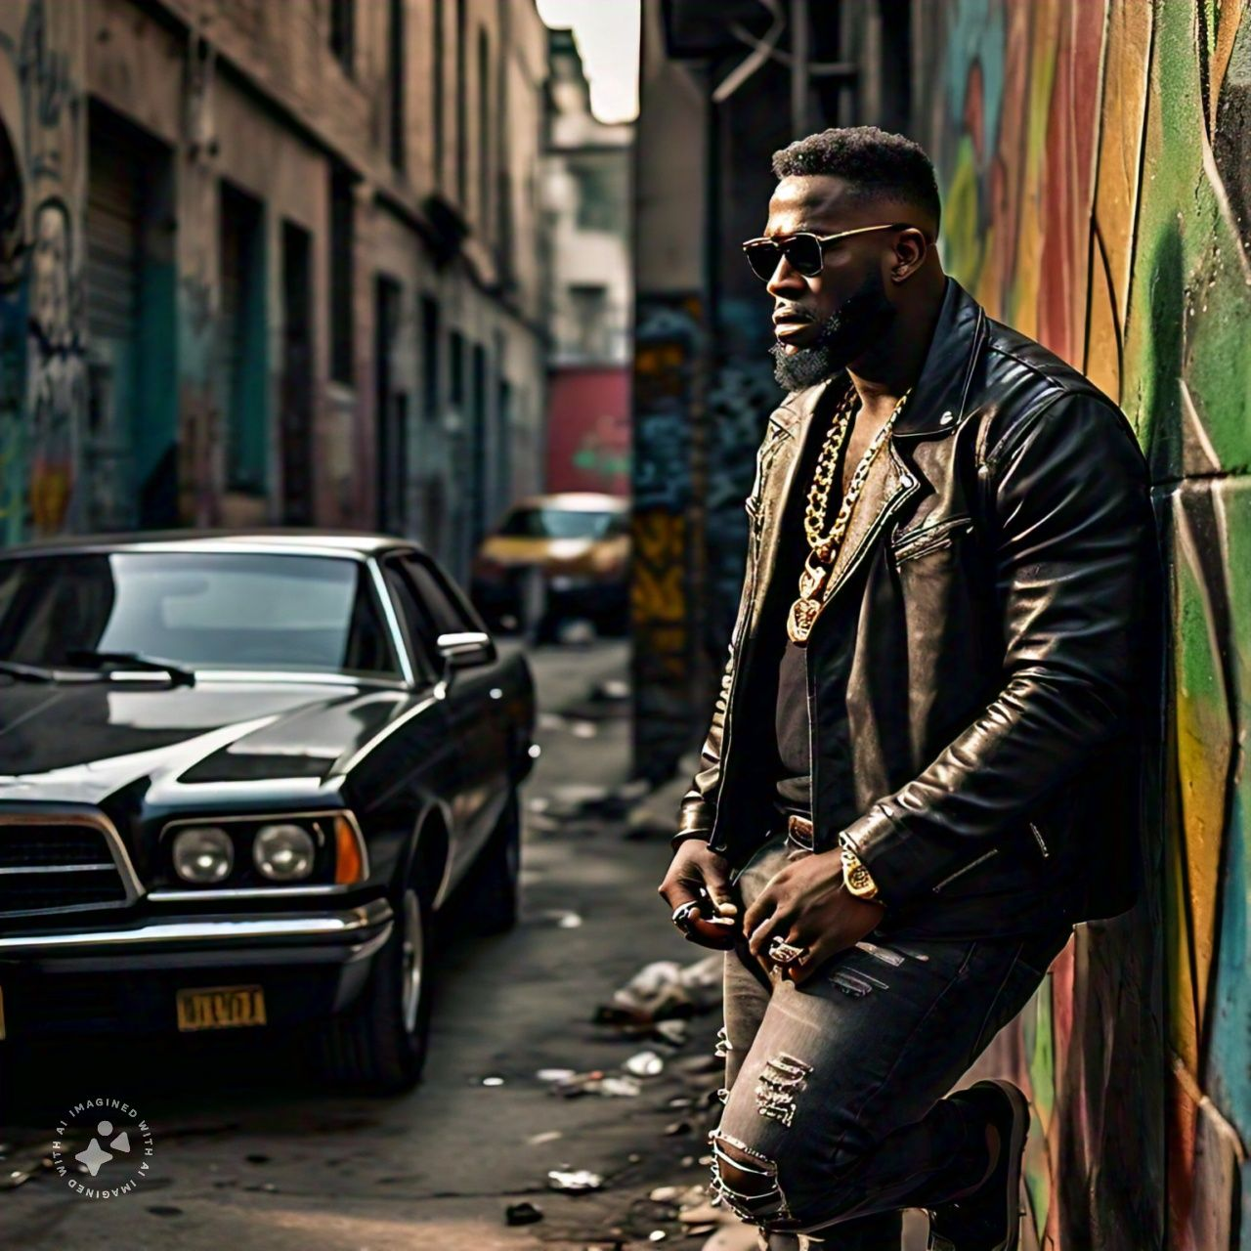
Another Ugly story

Slide 20
LESSONS CONTINUE
6. Put in place a good customer follow up and support system - Reps lie a lot but regular interaction between head office and customers reduce this to barest minimum
7. Instant rep account reconciliation system helps - Once a rep makes payments, deduct and tell him his current outstanding. if he is sent stock add and tell him his balance Empathy builds loyalty
8. Financial literacy and finance management training is key - Financial illiteracy is a key factor that leads reps to defraud their companies
Do not overload a rep with goods beyond his financial capacity - the more you give excess goods to rep the more likely he will defraud you

Slide 21

Good story

Slide 22
LESSONS CONTINUE
3. Don't drop a rep in a territory that you can't visit - A rep in a territory you can't visit is more likely to misbehave
4. Don't deploy a rep without effective tracking system in place - A rep you can't easily track is more likely to misbehave
5. over familiarity kills - Once rep get too familiar with their managers, it opens doors for misbehavior and laxity
6. Transparency is critical - if management engages in shady deals then their reps most likely will engage in shady deals with their customers
7. Staff resident visit is usually first way to notice financial recklessness - A rep earning 100k and living in an executive apartment is a signal that management should put more touch light on him

Slide 23

THANK YOU

